Slide 1
Data Science
Unit-II
Multivariate Analysis

Slide 2
Multivariant Data
Multivariate data refers to data that involves multiple variables or measurements. Each observation in the dataset has values for multiple attributes. Analyzing multivariate data is essential in many fields, including statistics, data science, machine learning, and various scientific disciplines.
Characteristics of Multivariate Data
Multiple Variables: Multivariate data contains more than one variable or attribute per observation.
Complexity: The relationships between variables can be complex, requiring sophisticated statistical and computational methods for analysis.
Higher Dimensionality: With more variables, the data becomes high-dimensional, which can lead to challenges in visualization and interpretation.
Example: Healthcare, Financial, Environment

Slide 3
Multivariant Analysis
Multivariate analysis encompasses all statistical techniques that are used to analyze more than two variables at once.
The aim is to find patterns and correlations between several variables simultaneously—allowing for a much deeper, more complex understanding of a given scenario than you’ll get with bivariate analysis.
There are three categories of analysis to be aware of:
Univariate analysis, which looks at just one variable: Bar charts, Pie charts, Histograms
Bivariate analysis, which analyzes two variables, Ex: Scatter plot, Regression and Correlation anlysis
Multivariate analysis, which looks at more than two variables Ex: Clustering etc

Slide 4
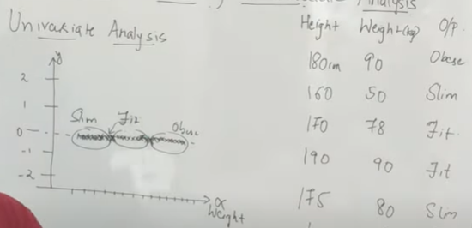
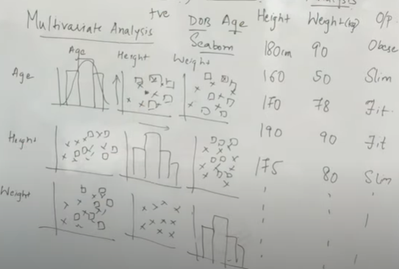
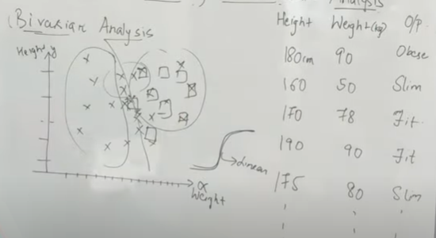
Univariate, Bivariate & Multivariate Analysis
Used Seaborn
Correlation plays major role = +ve, -ve, 0 values

Slide 5
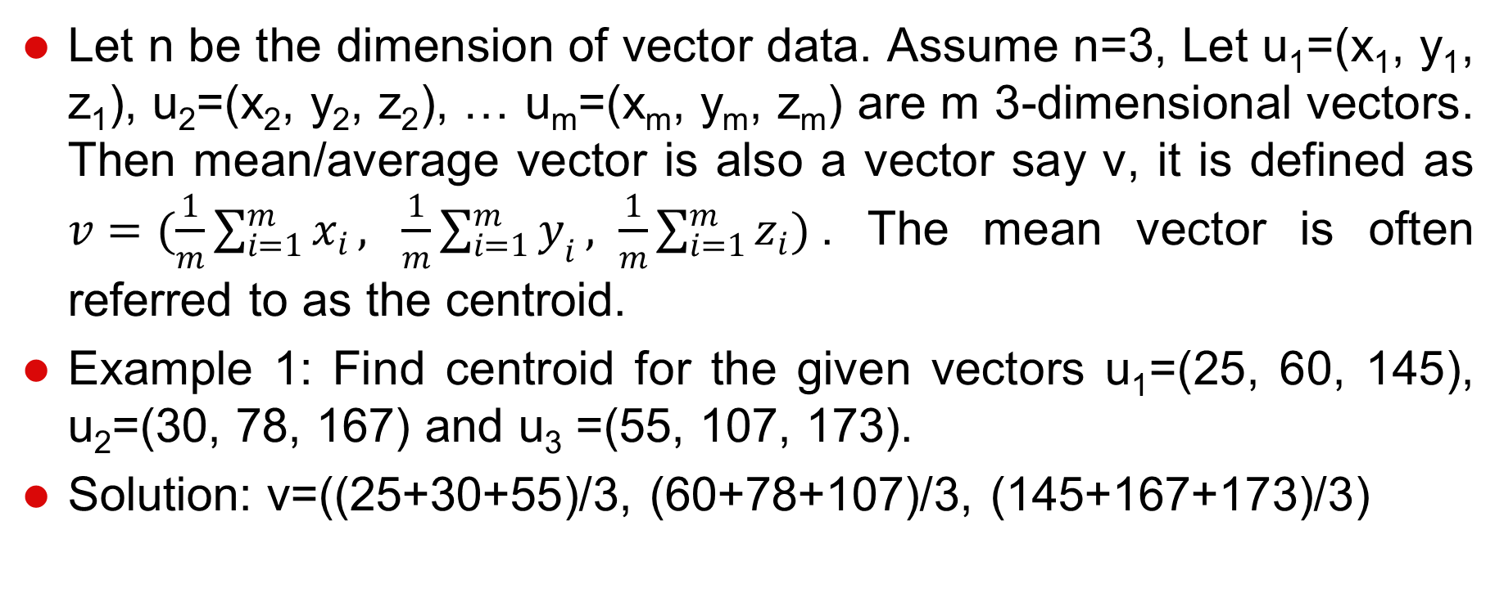
Mean Vector: Definition

Slide 6
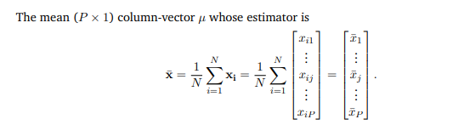
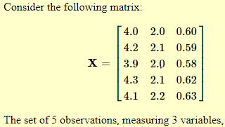

Mean vector

Slide 7
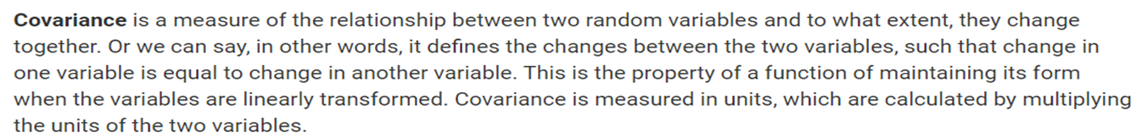
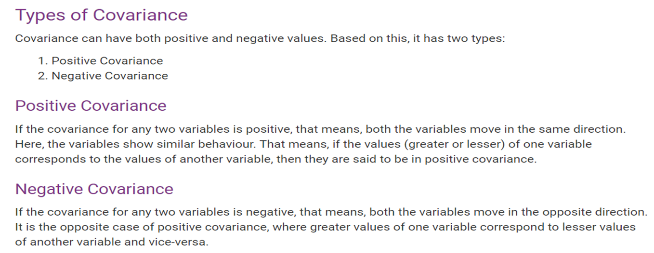
  Covariance and Correlation

Slide 8
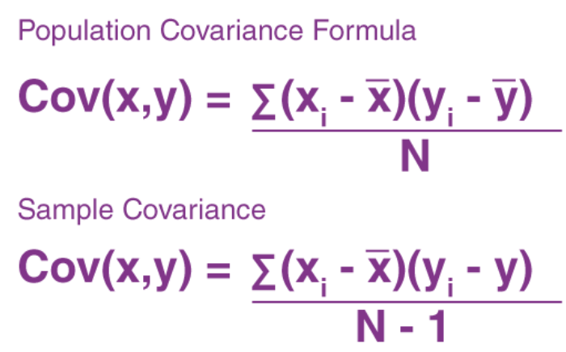
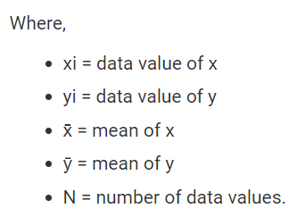
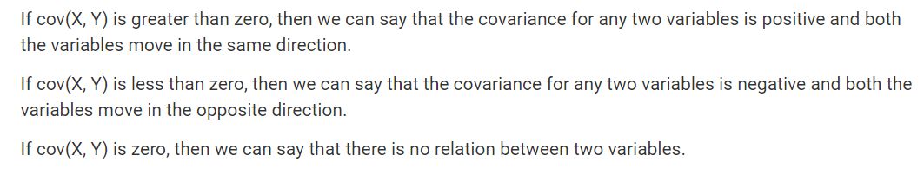

Slide 9
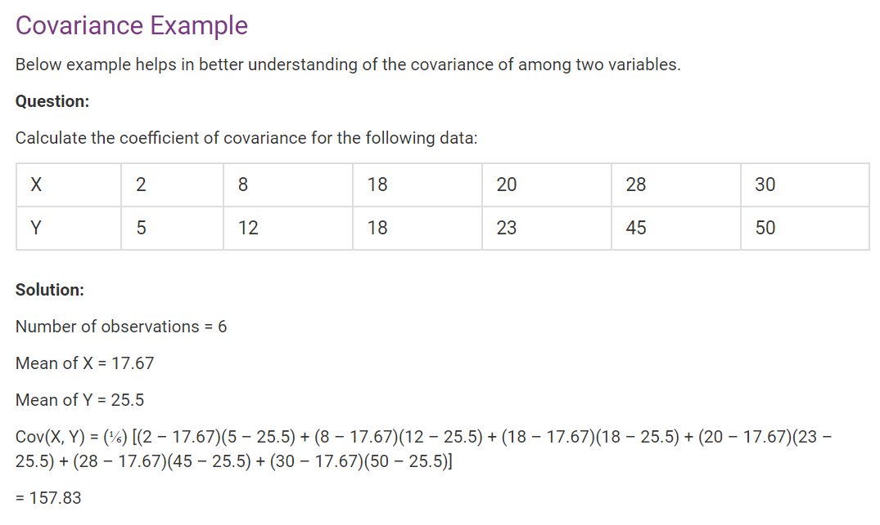

Slide 10
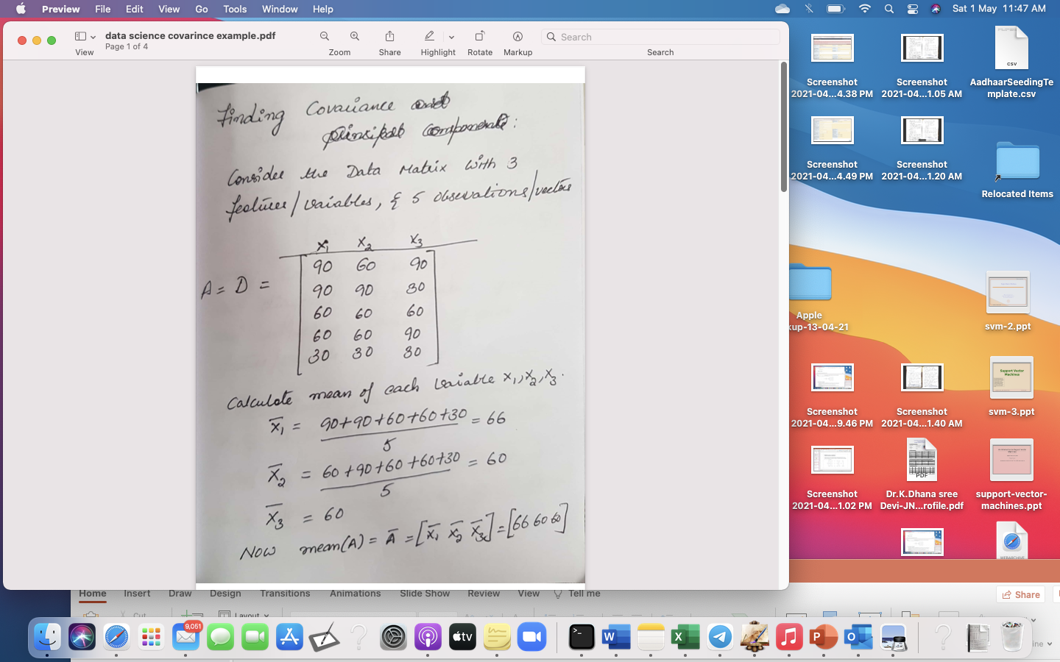
Example :

Slide 11
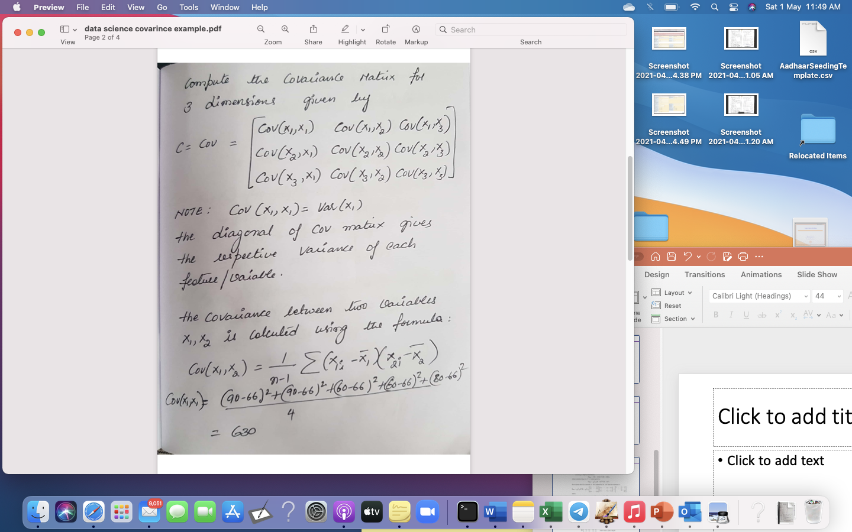

Slide 12
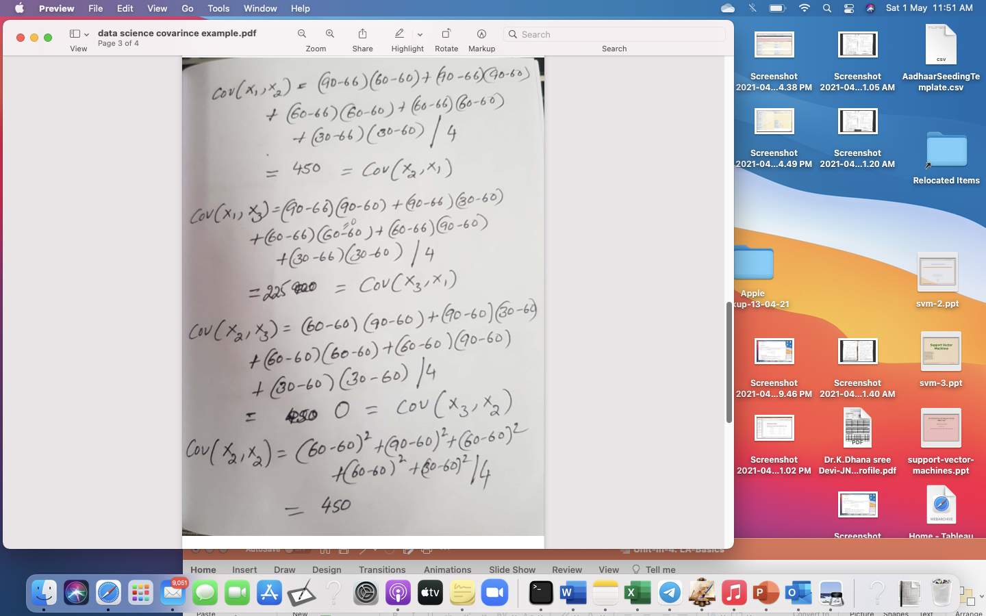

Slide 13
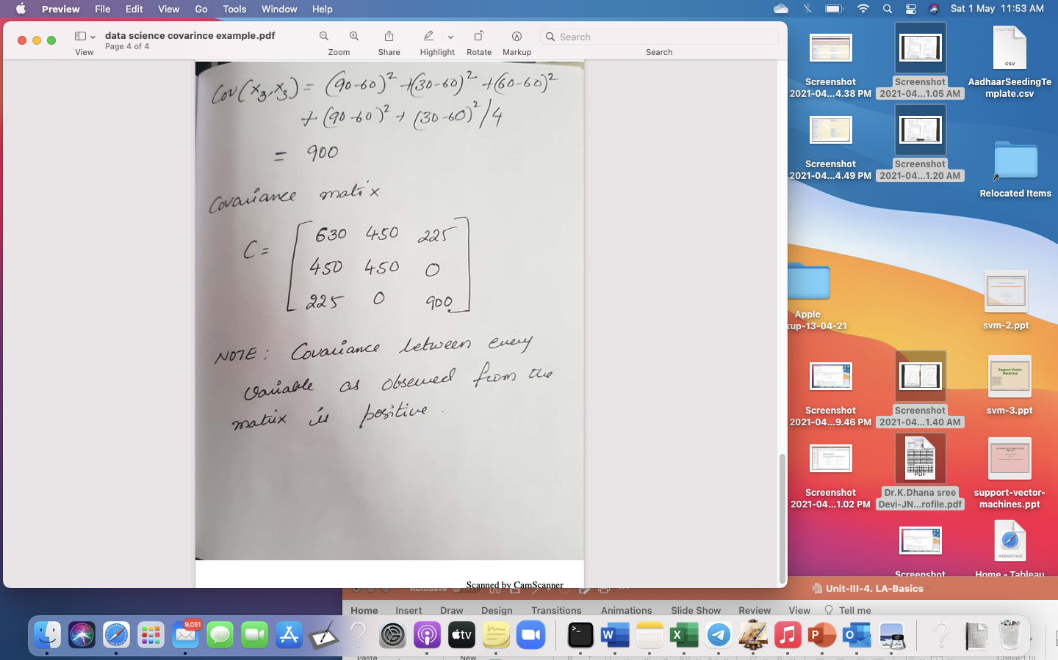

Slide 14
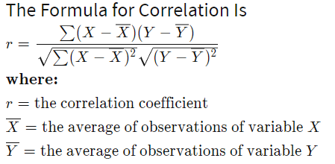
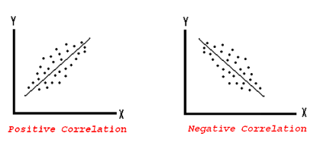
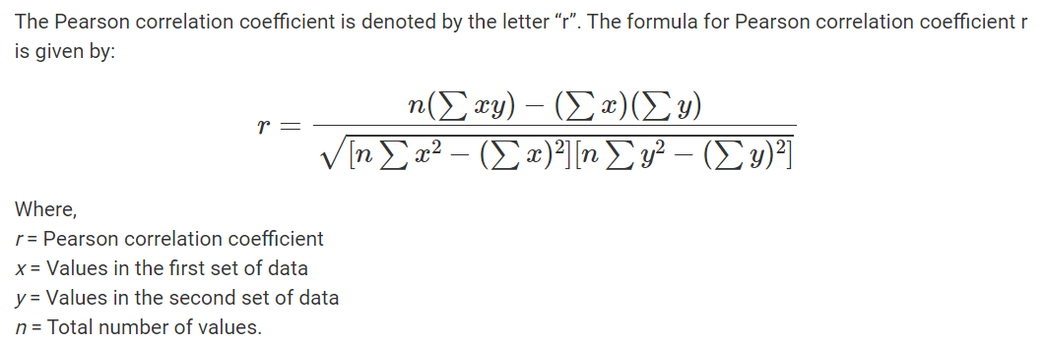
Correlation
Correlation analysis is a method of statistical evaluation used to study the strength of a relationship between two, numerically measured, continuous variables.
Computed as Correlation co-efficient
Value ranges between – (-1) to (+1)
Positively Correlated, Negatively correlated, Not correlated
The strength of a correlation indicates how strong the relationship is between the two variables. The strength is determined by the numerical value of the correlation

Slide 15
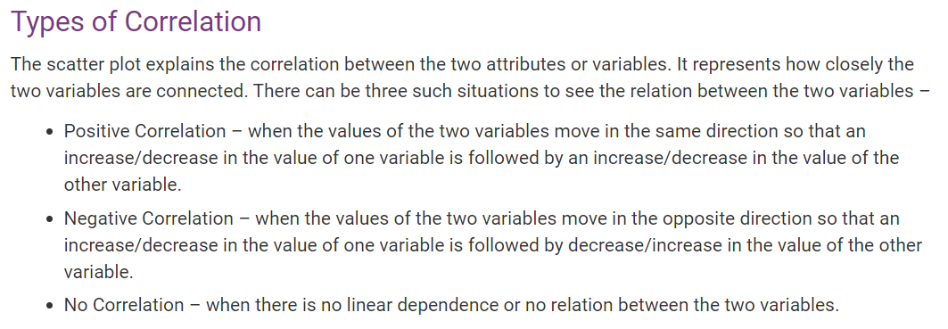

Slide 16
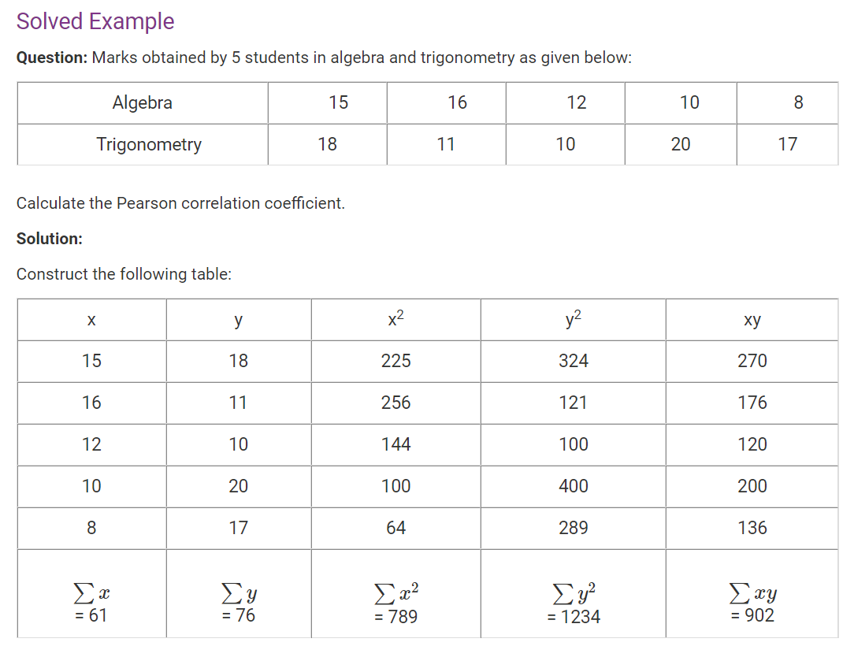
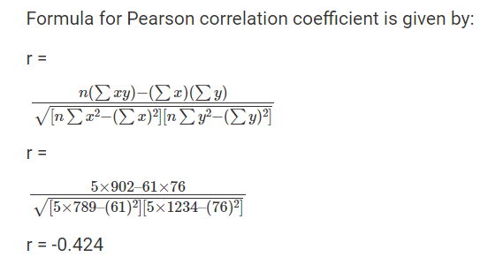

Slide 17
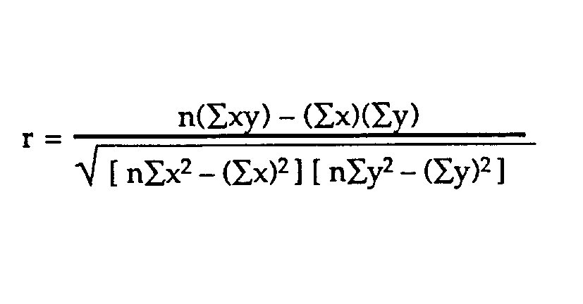
Example problem:
Business problem: The healthcare industry want to develop a
medication to control glucose levels. For this it want to study does age
have impact on raise in glucose levels
SUBJECT | AGE X | GLUCOSE LEVEL Y | XY | X² | Y²
1 | 43 | 99 | 4257 | 1849 | 9801
2 | 21 | 65 | 1365 | 441 | 4225
3 | 25 | 79 | 1975 | 625 | 6241
4 | 42 | 75 | 3150 | 1764 | 5625
5 | 57 | 87 | 4959 | 3249 | 7569
6 | 59 | 81 | 4779 | 3481 | 6561
Σ | 247 | 486 | 20485 | 11409 | 40022
From our table:
Σx = 247
Σy = 486
Σxy = 20,485
Σx² = 11,409
Σy² = 40,022
n is the sample size=6
The correlation coefficient =
6(20,485) – (247 × 486) / [√[[6(11,409) – (247²)] × [6(40,022) – 486²]]]. = 0.5298 (strength and direction)
The range of the correlation coefficient is from -1 to 1.
here result is 0.5298 or 52.98%, which means the variables have a moderate positive correlation( some what more ). We cant infer with 52.98% correlation that age has impact on rise in glucose levels. We need more data to analyze

Slide 18
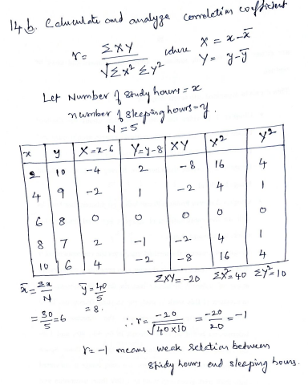

Slide 19
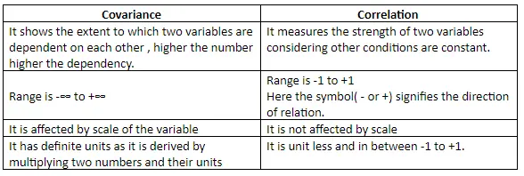
Covariance vs Correlation

Slide 20

Precision Matrix: More generally
.
The precision matrix of a random vector is the inverse of its covariance matrix.
If A is the covariance matrix the precision matrix is given by
P=A⁻¹
Find the inverse of the 2×2 covariance matrix below A, if it exists

Slide 21

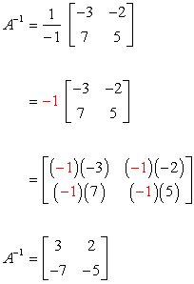
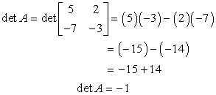
Its inverse is calculated using the formula

Slide 22
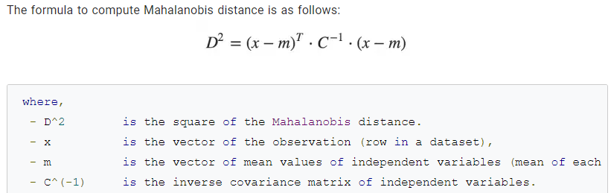
Mahalanobis distance
Mahalanobis distance is an effective multivariate distance metric that measures the distance between a point and a distribution. It is an extremely useful metric having, excellent applications in multivariate anomaly detection, classification on highly imbalanced datasets and one-class classification.

Slide 23
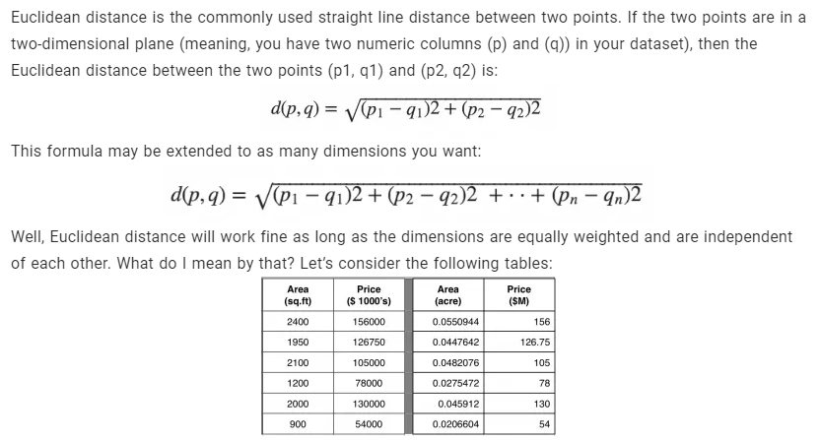
What’s wrong with using Euclidean Distance for Multivariate data?

Slide 24
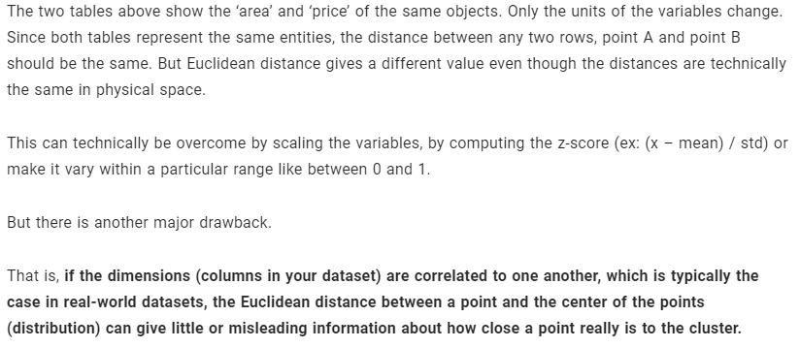
Problem 1

Slide 25
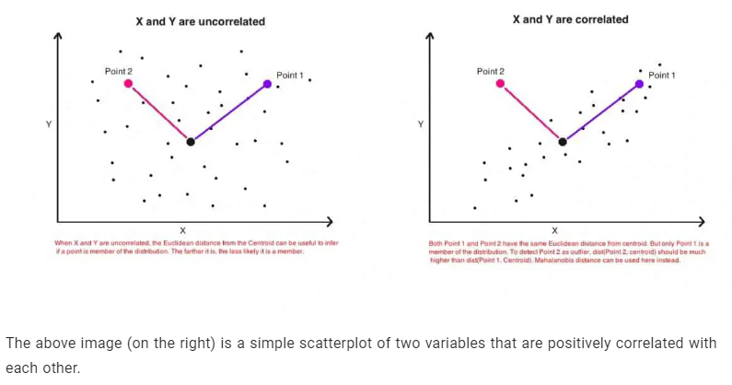
Problem 2
In daily life, when we talk about distance, we use the term "distance between point A and point B". It is used interchangeably with "length".
Both Mahalanobis distance and Euclidean distance are labeled as "distance", but they can also be used for things that are not "length". In Data Science , distance is sometimes used as an indicator of "A and B are similar".

Slide 26
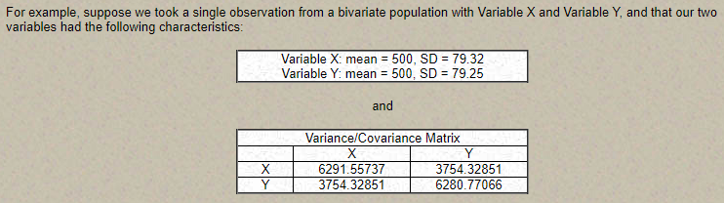
Mahalanobis distance: Example

Slide 27
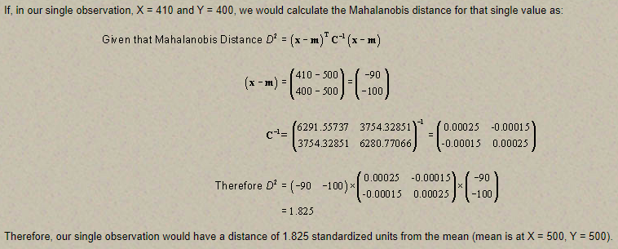
Mahalanobis distance: Example

Slide 28
Parameter estimation
Parameter estimation involves determining the values of parameters (e.g., mean, variance) that characterize a statistical model. It makes inferences about the population from sample data.
Methods of Parameter Estimation:
Maximum Likelihood Estimation (MLE):
  Explanation: Estimates parameters by maximizing the likelihood function, which measures how likely the observed data is given the parameters.
  Application: Widely used due to its desirable properties, such as consistency and asymptotic normality.
Method of Moments:
  Explanation: Estimates parameters by equating sample moments (e.g., sample mean, sample variance) to population moments.
  Application: Simpler than MLE but less efficient in some cases.
Bayesian Estimation:
  Explanation: Incorporates prior information about parameters into the estimation process, updating beliefs with observed data using Bayes' theorem.
  Application: Useful when prior information is available and when dealing with complex models.

Slide 29
Parameter estimation
Examples of Parameter Estimation:
Mean Vector Estimation.
Covariance Matrix Estimation

Slide 30
Estimation of Missing Values in Multivariate Analysis
Missing values occur when no data value is stored for a variable in an observation.
Challenges: Missing values can bias the results and reduce the statistical power of the analysis.
Common Techniques for Estimating Missing Values:
Mean/Median Imputation:
  Explanation: Replace missing values with the mean or median of the variable.
  Pros/Cons: Simple but can reduce variability and introduce bias.
Regression Imputation:
  Explanation: Predict missing values using regression models based on other variables.
  Pros/Cons: More accurate than mean/median imputation but can be complex.
Multiple Imputation:
  Explanation: Create multiple datasets with different imputed values and combine results.
  Pros/Cons: Accounts for uncertainty but is computationally intensive.
K-Nearest Neighbors (KNN) Imputation:
  Explanation: Impute missing values based on the values of the nearest neighbors.
  Pros/Cons: Effective for small datasets but can be slow for large datasets.

Slide 31
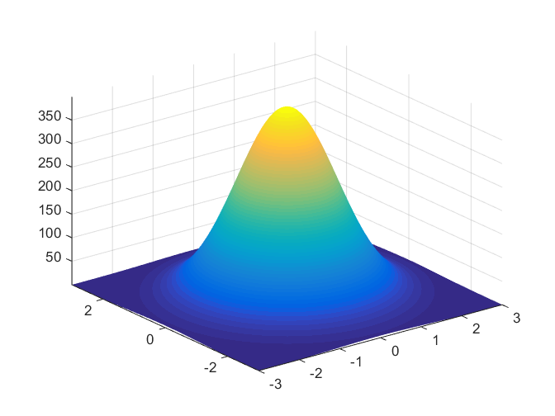
Multivariate normal distribution
The multivariate normal distribution is useful in analyzing the relationship between multiple normally distributed variables, and thus has heavy application to biology and economics where the relationship between approximately-normal variables is of great interest.
A generalization of the univariate normal distribution to multiple variables.

Slide 32
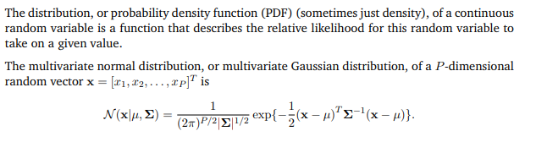
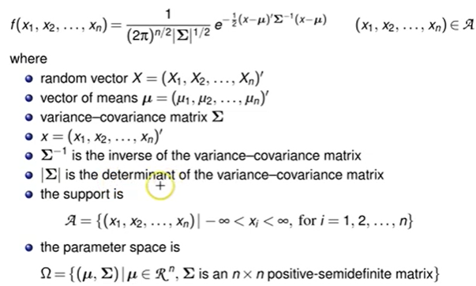
Multivariate normal distribution

Slide 33
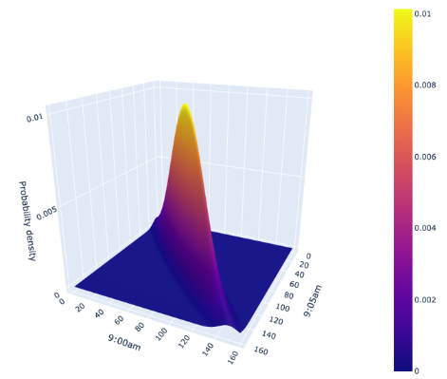
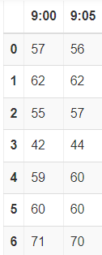
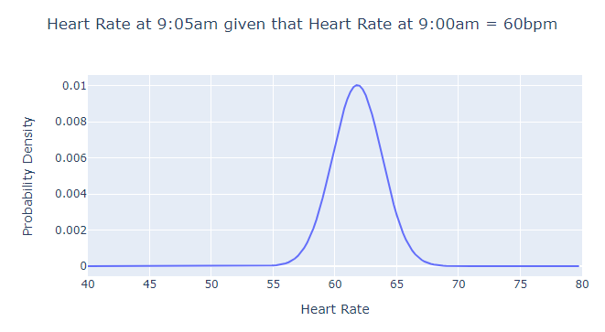
Example:
Imagine you want to measure two variables: your heart rate at 9:00am, and your heart rate at 9:05am in beats per minute (bpm). There is likely correlation between these two variables, i.e., your heart rate at 9:05am is probably pretty similar to your heart rate at 9:00am. You measure this data for 7 days, and you get the following data:

